Slide 1
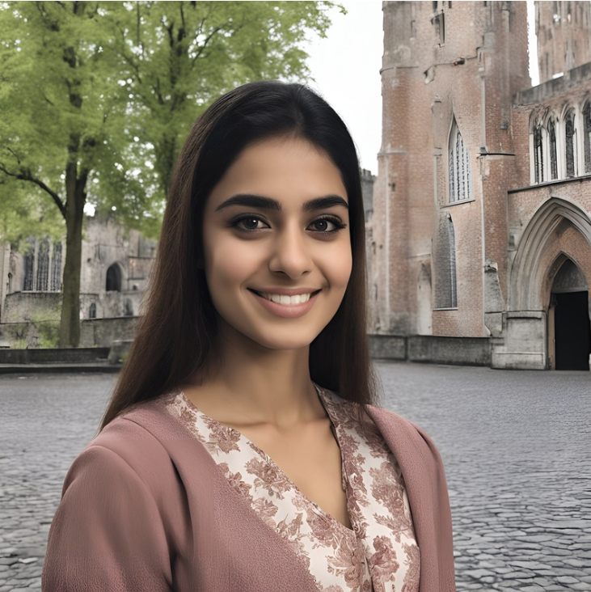
“I believe that passion and effort are the keys to unlocking the doors of success.”
Add image that represents this persona
Goals
To complete degree and gain valuable internship experience.
To increase her responsibilities in her current role and eventually secure a full-time position.
To expand professional network
To develop personal skills.
Frustrations
She felt a lack of working experience.
She felt time is not enough.
She worried about it’s hard to find an ideal job after graduation.
She feels the competition among peers is very intense.
Zareen
Age:
Education:
Hometown:
Family:
Occupation:
22
4th year university student
Bruges, Belgium
2 sisters
Project management intern for a large international firm
Zareen is about to complete her college.She has an internship job for a large international firm, where she is involved in various tasks ranging from project coordination to office administration. She takes every opportunity to learn from her mentor and to demonstrate her capabilities in a professional setting.

Slide 2

“Turning my hobbies into my job makes me passionate about work every day.”
Add image that represents this persona
Goals
To complete the online data analytics bootcamp.
To balance work, life, and learning.
To cut down on spending.
To find a career transition opportunity.
Frustrations
He feel time isn't enough.
He needs to reduce expenses.
He gets easily distracted while studying at coffee shops or co-working spaces.
He worries about career transition.
Elliot
Age:
Education:
Hometown:
Family:
Occupation:
44
Culinary school graduate
Omaha, Nebraska
Lives with partner
Cook
Elliot is a line cook in a small city, working mostly in the evenings. During the day, he attends an online data analytics bootcamp to gain new skills, studying for 3-4 hours at local coffee shops or co-working spaces. To manage the high cost of the bootcamp, he tries to save on food and transportation. Elliot's main focus is balancing his job, studies, and spending quality time with his partner and hobbies.

Slide 3
“Relevant personal quote that captures the persona’s attitude and personality”
Add image that represents this persona
Goals
The related objectives this person wants to successfully complete
Frustrations
The issues or pain points that they encounter or try to avoid
Name
Age:
Education:
Hometown:
Family:
Occupation:
Brief story or scenario that conveys the persona’s user journey, highlighting their goals, frustrations, and other relevant context.

